Slide 1
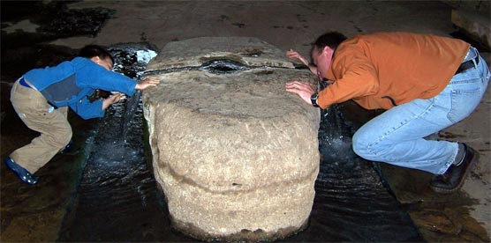

Drinking from the spring
The benefits of data services, tools, and leadership to students
By Richard Clark
Department of Earth Sciences
Millersville University
16 October 2009
Thought about calling this: “Matching the Leathers”

Slide 2
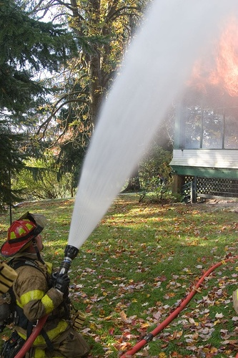
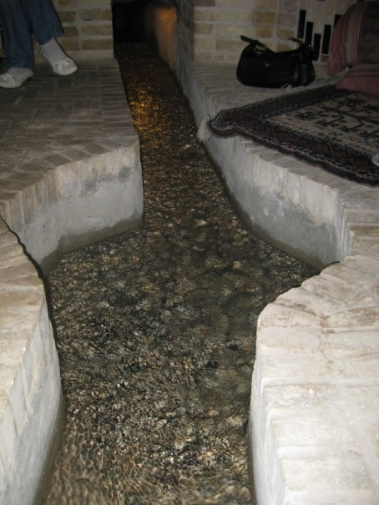
The proper metaphor…
The fire hose spews forth an overwhelming volume that saturates, quells, stifles, controls, and thwarts interaction
A spring nurtures, refreshes, renews vigor, provides resource, enables, and allows one to carry on and seek future opportunity

Slide 3
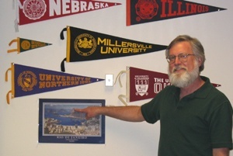
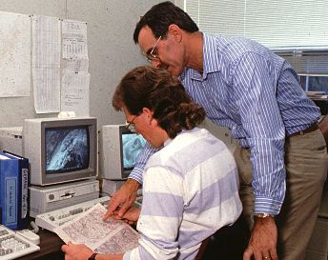
What’s this Unidata thing?
1987 before
1987 after
Advances in computing; 3.5” floppies

Slide 4
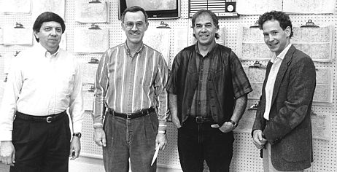
In 1989, DeSouza joined the UserCom
And life became frantic for the rest of us!

Slide 5
Empowering
DeSouza became the chair of the MU Network Implementation Committee
Clark joined the Academic Computing Committee
Hörst maintained the local Unidata/Zephyr broadcast system (56 kbits/s) – affordability brokered by Unidata
Students kept snow off the dish
Unidata enabled Millersville Meteorology and empowered us to demand high-rate data broadcast and early planning for Internet connectivity. This leadership continues today.
Unidata Equipment Grants

Slide 6
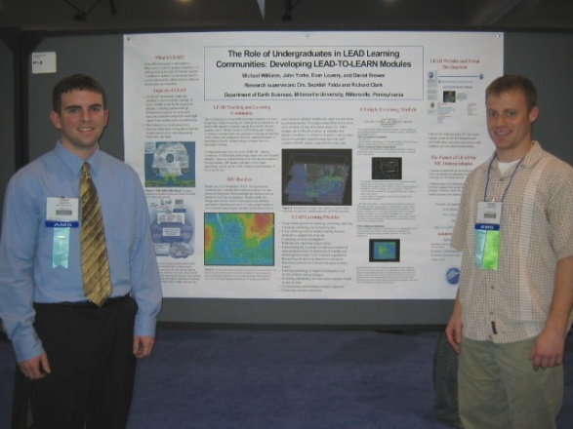
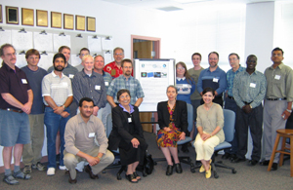
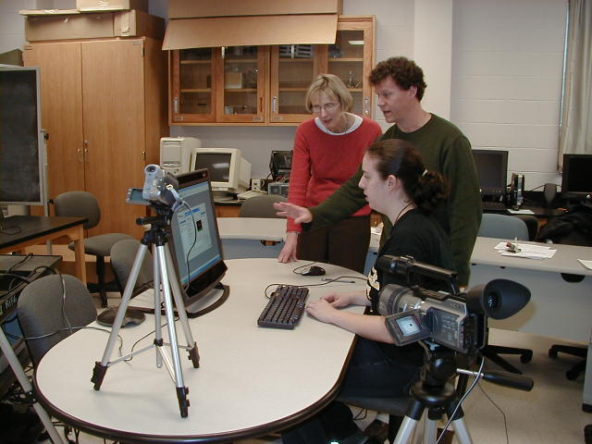
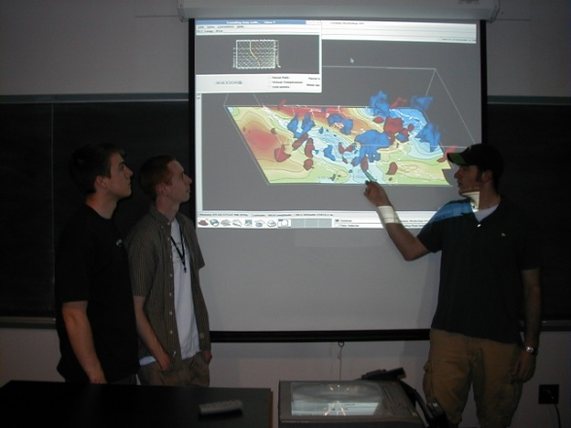
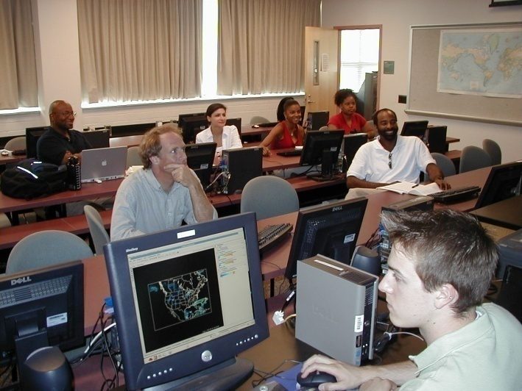
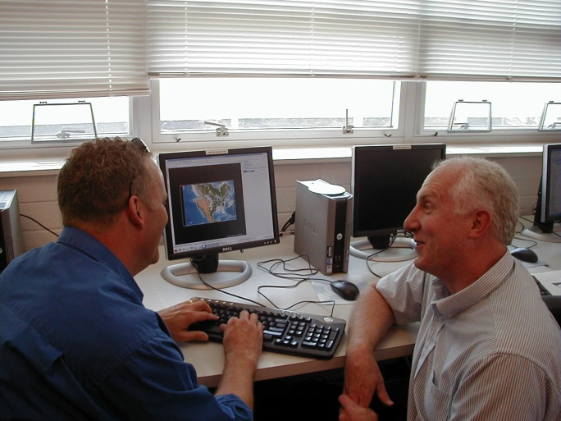
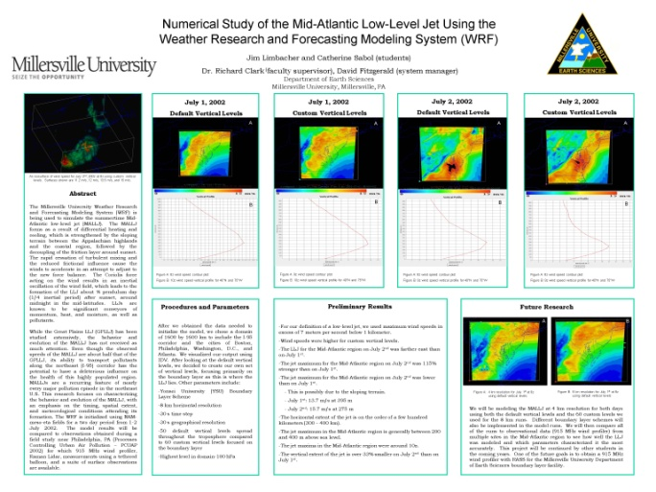
Enabling
Undergraduate research
2004 Unidata Workshop at MU
Cognitive study with GM
MU-Howard IDV workshop
Middle/High School Outreach

Slide 7
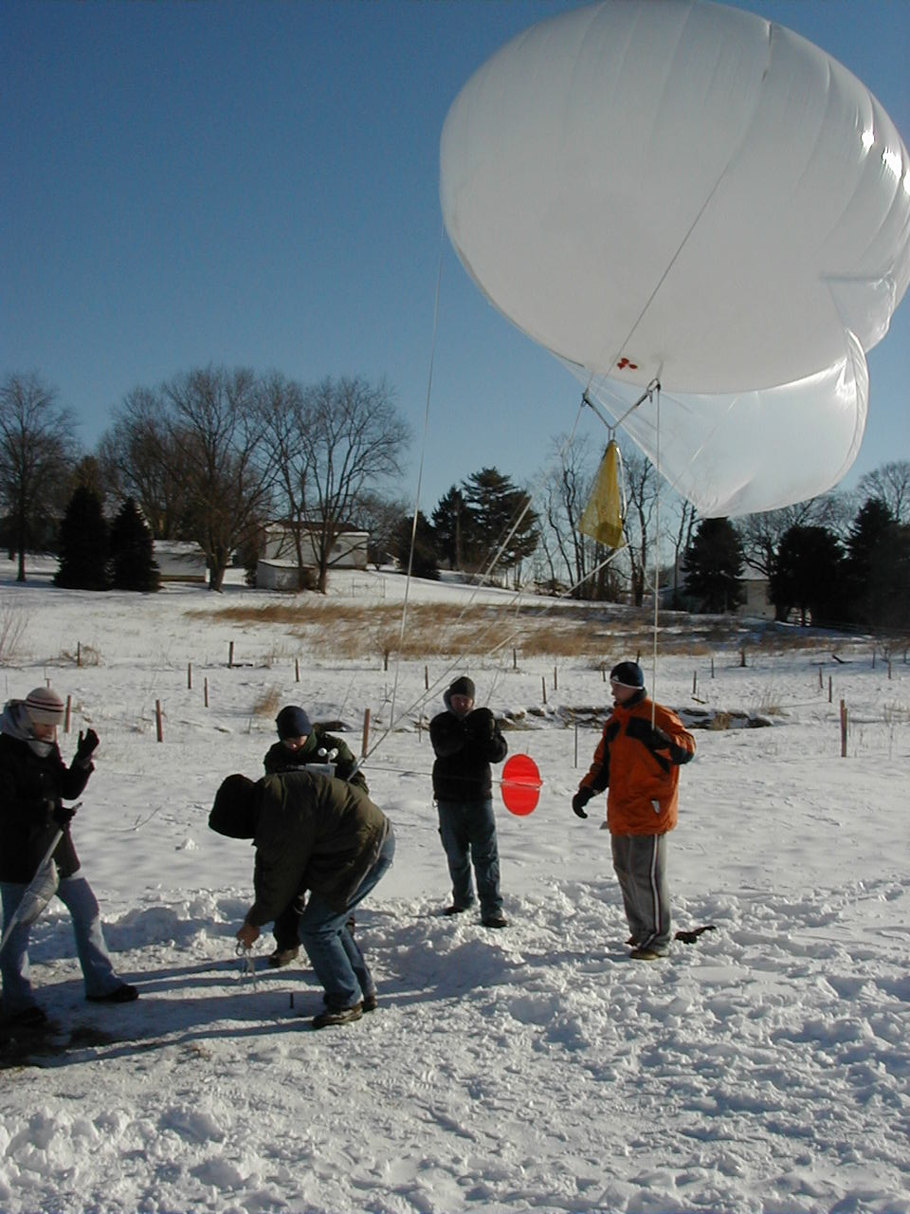
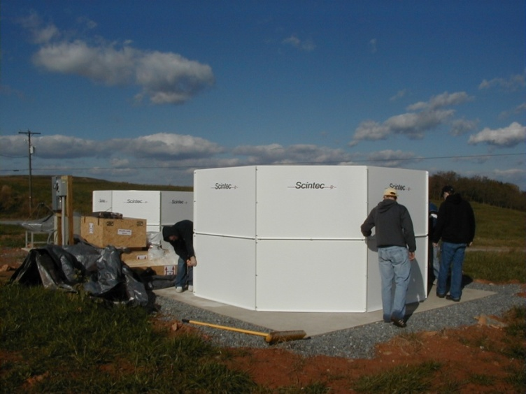
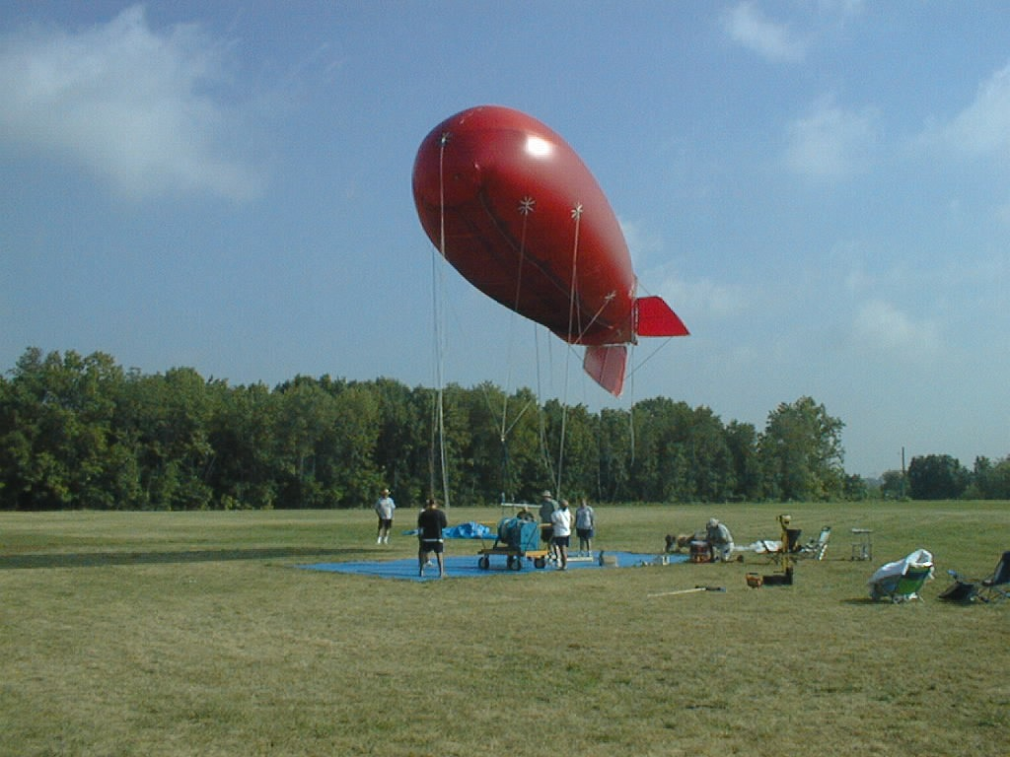
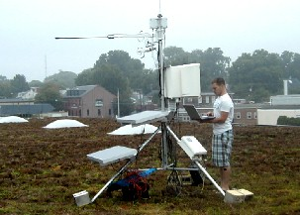
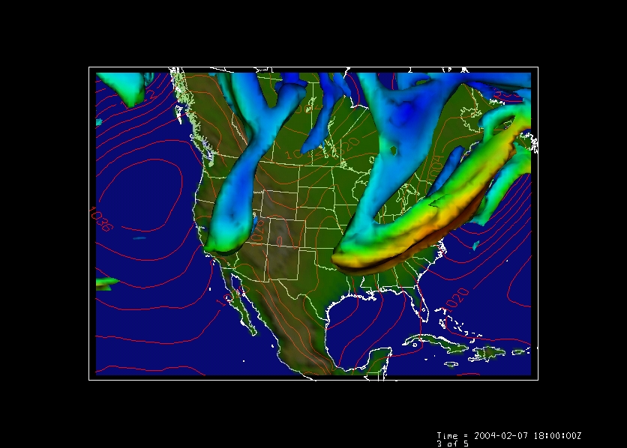
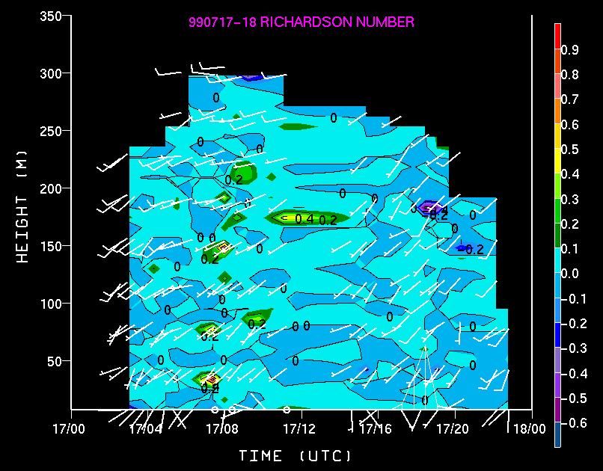
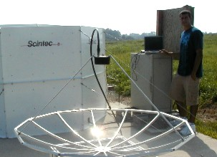
Providing Resources

Slide 8
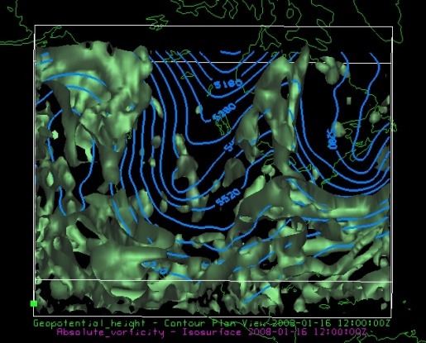
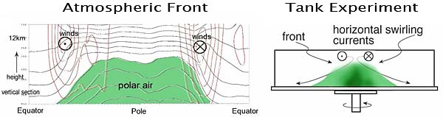
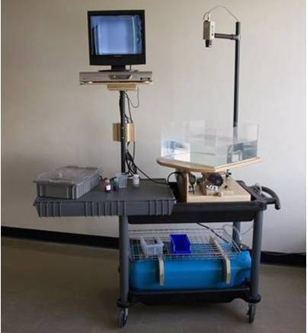
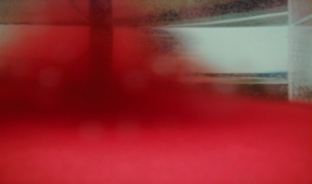
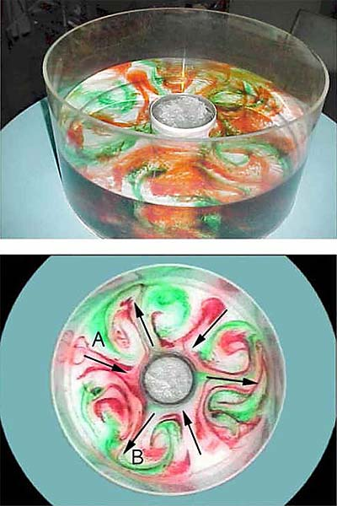
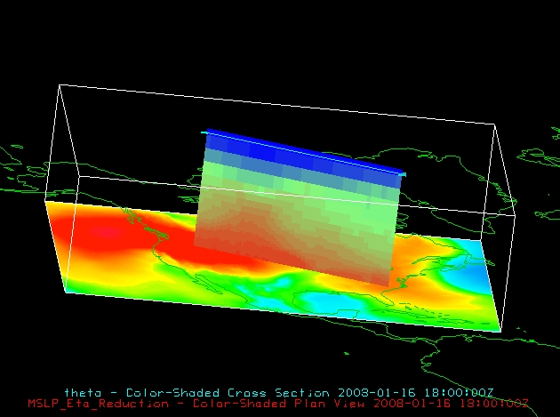
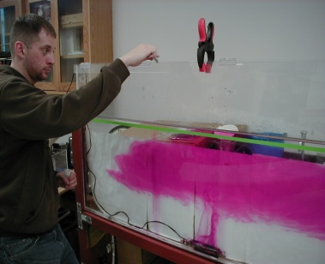
Geophysical Fluids: Weather in a Tank

Slide 9
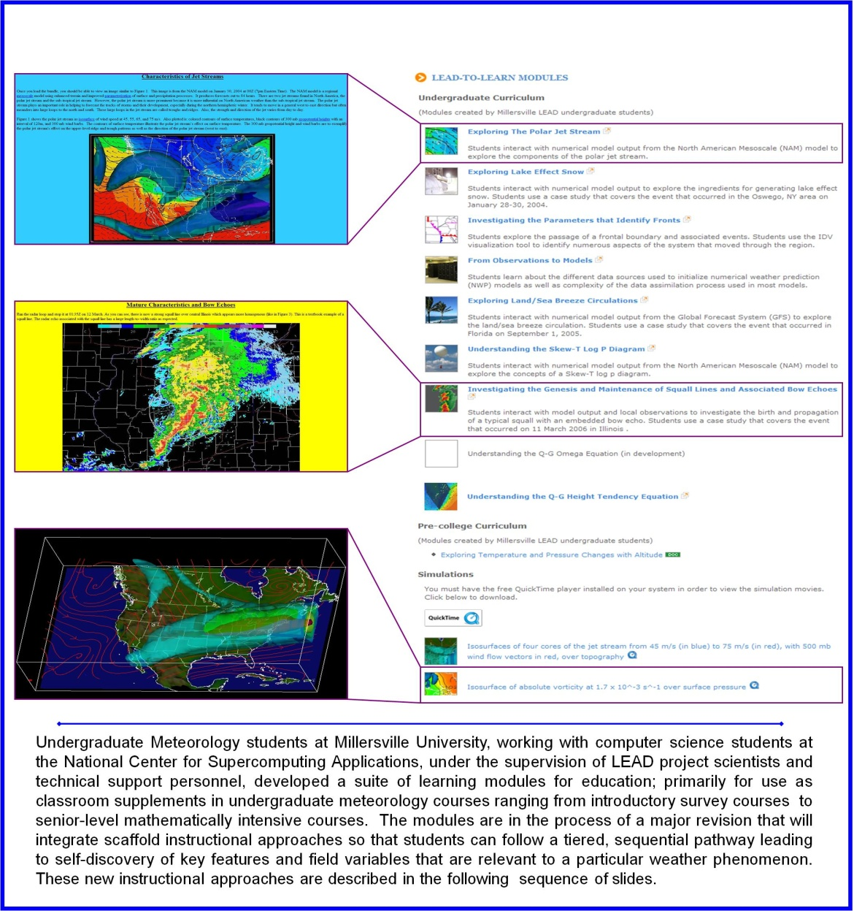
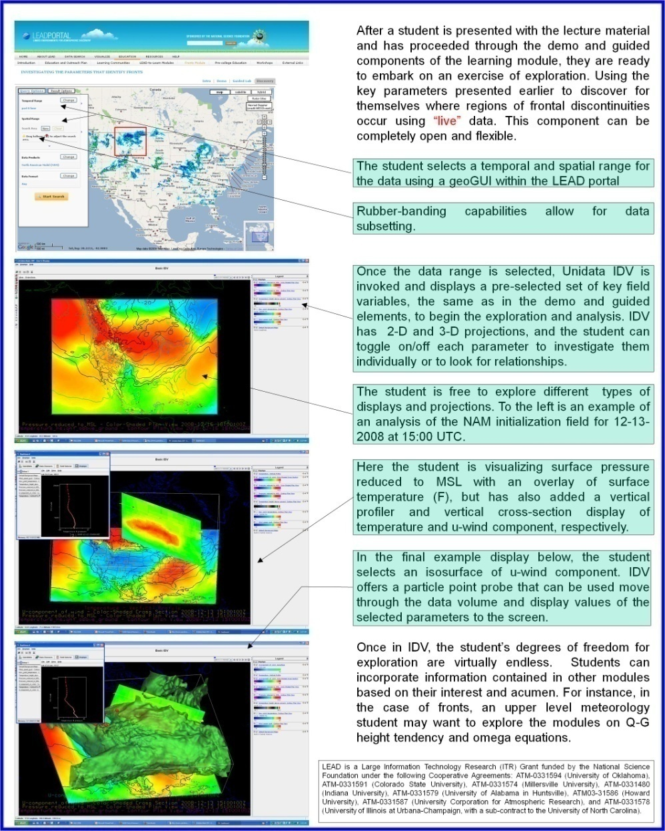
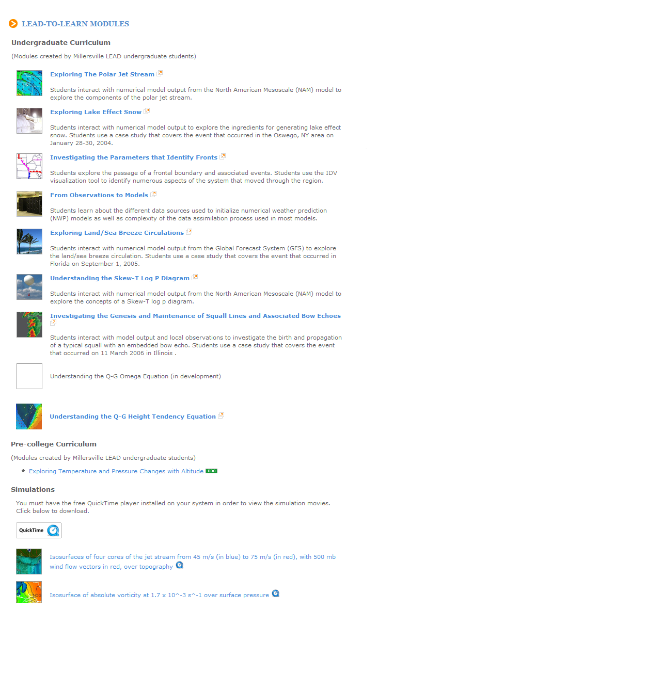
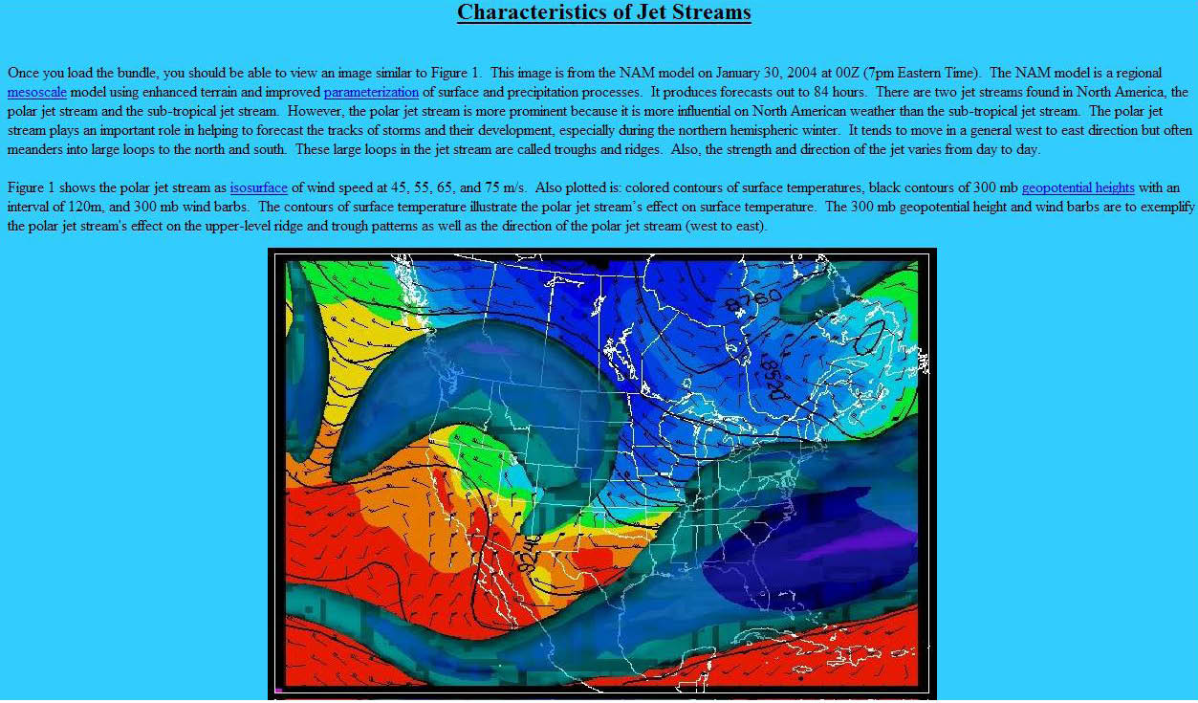
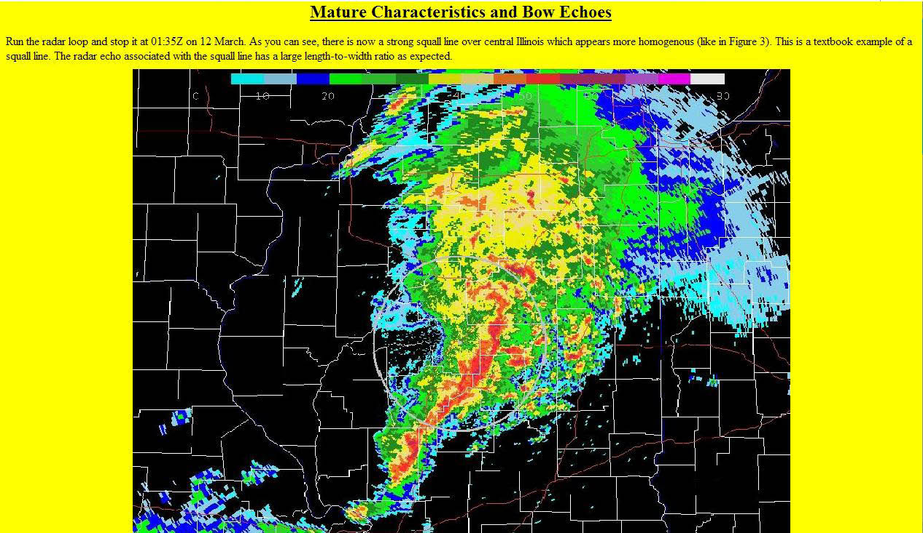
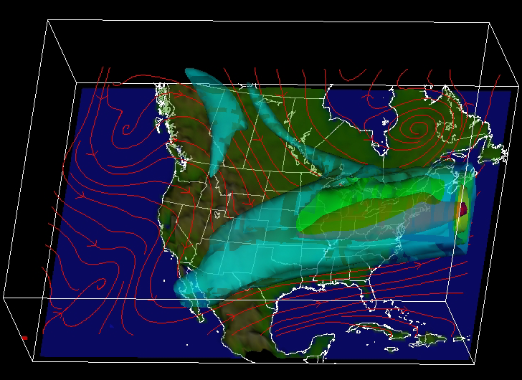
LEAD-to-LEARN:
An instructional pathway for meteorology education using a science gateway
Undergraduate Meteorology students at Millersville University, working with computer science students at the National Center for Supercomputing Applications, under the supervision of LEAD project scientists and technical support personnel, developed a suite of learning modules for education; primarily for use as classroom supplements in undergraduate meteorology courses ranging from introductory survey courses to senior-level mathematically intensive courses. The modules are in the process of a major revision that will integrate scaffold instructional approaches so that students can follow a tiered, sequential pathway leading to self-discovery of key features and field variables that are relevant to a particular weather phenomenon. These new instructional approaches are described in the following sequence of slides.

Slide 10
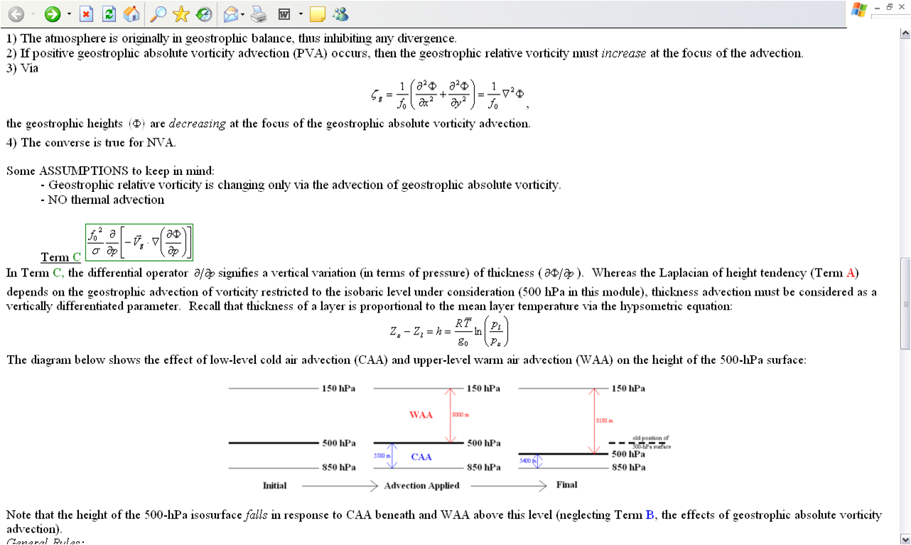
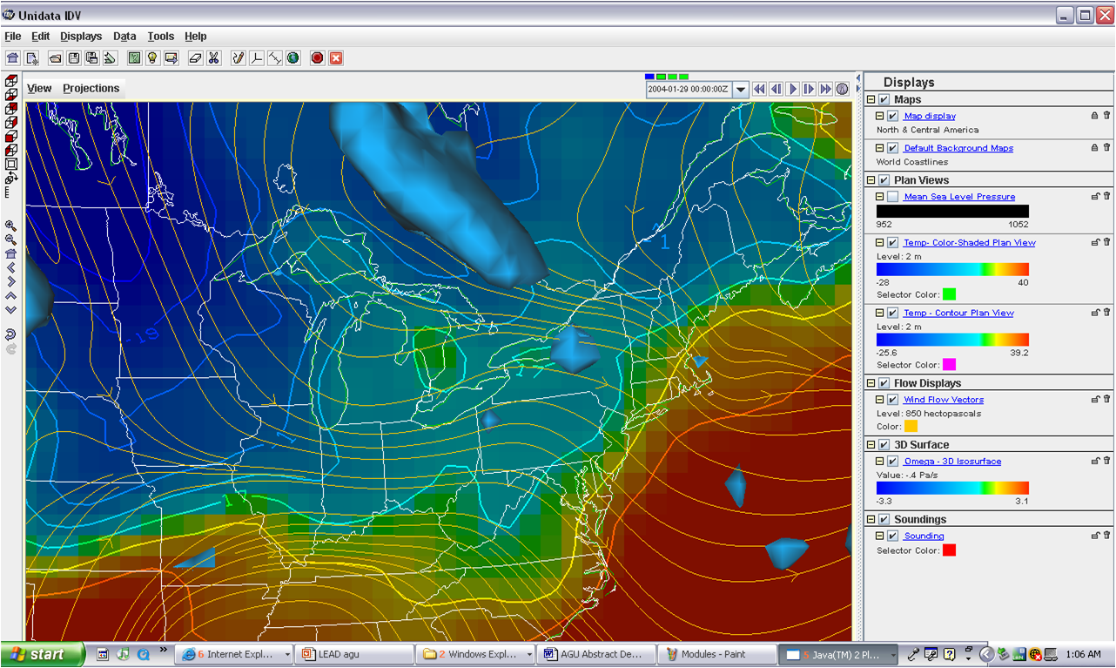
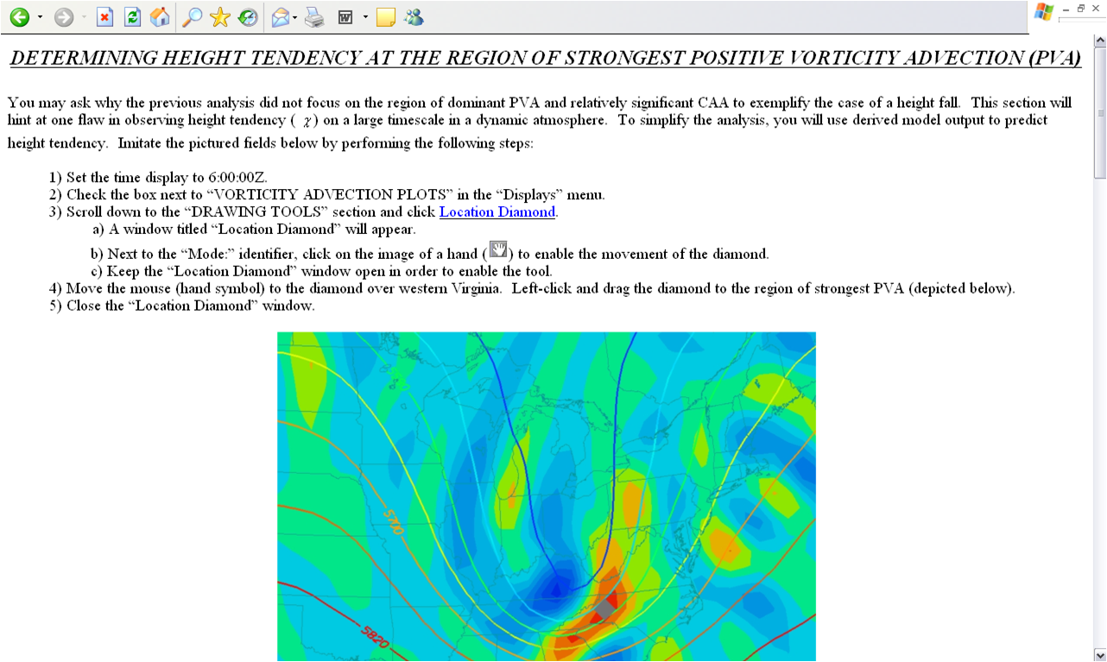
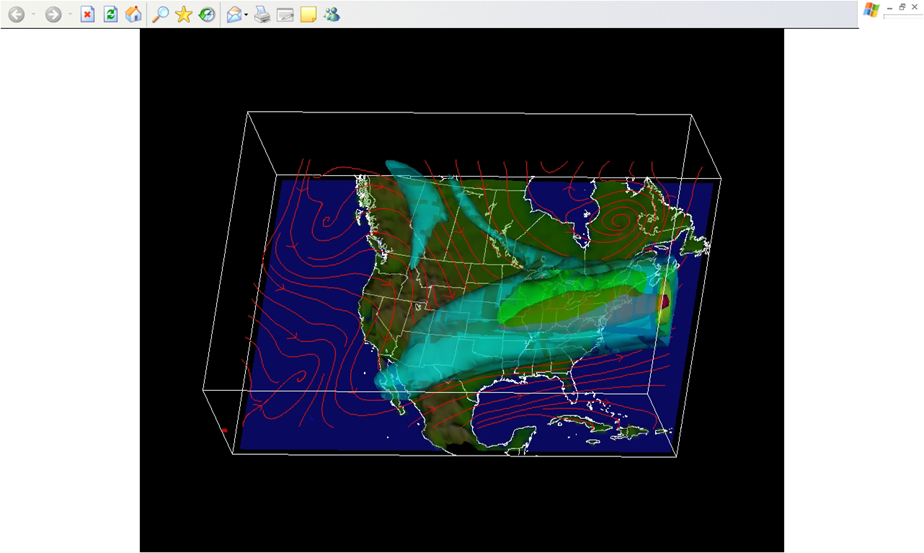
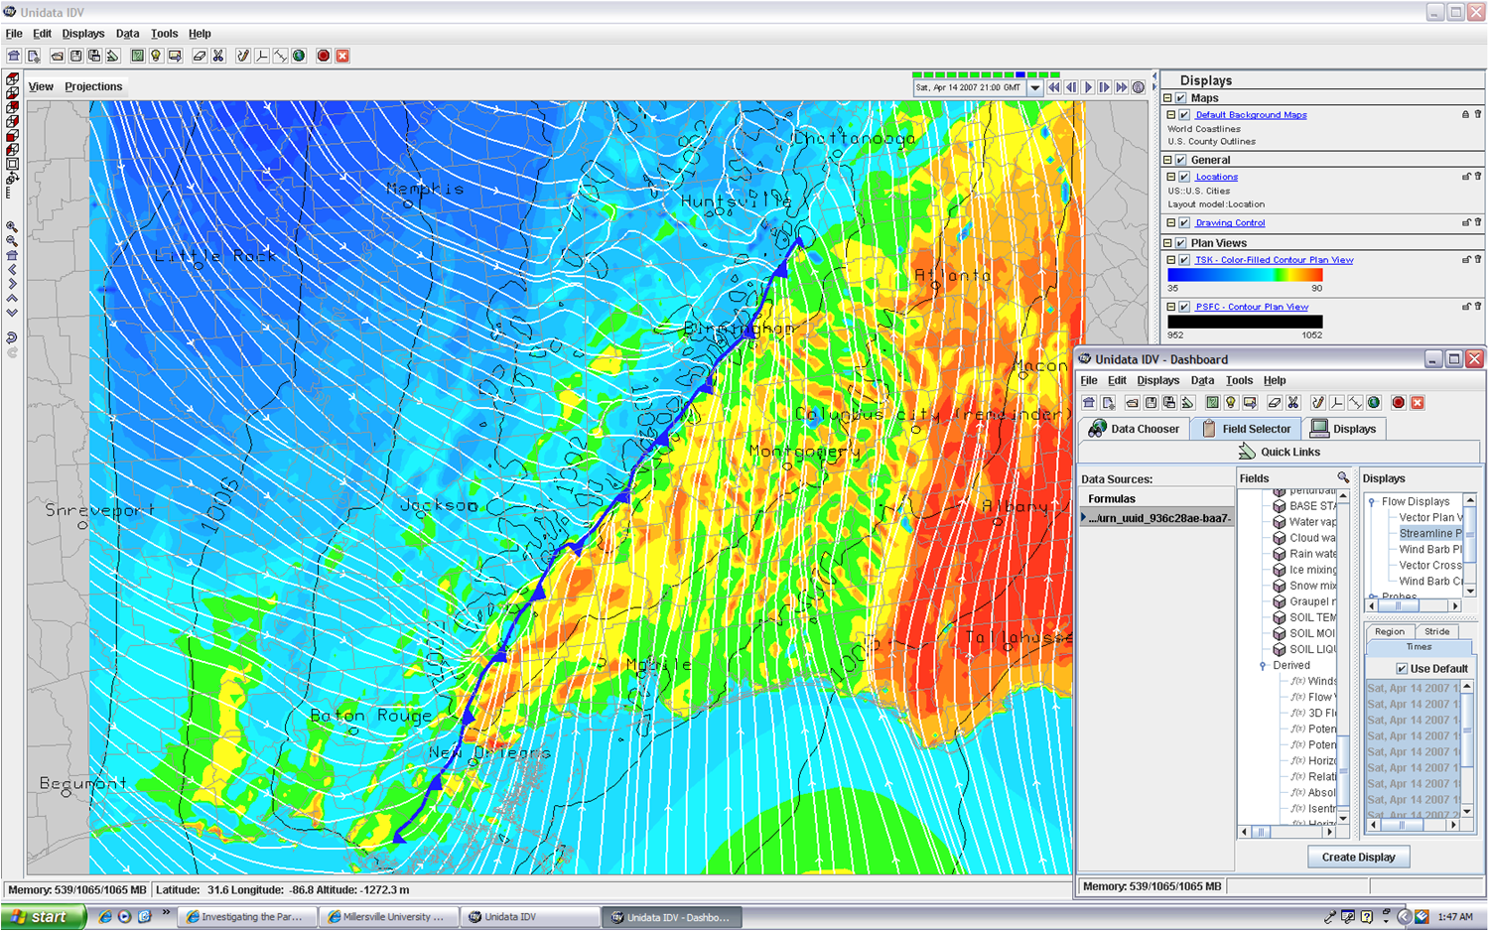
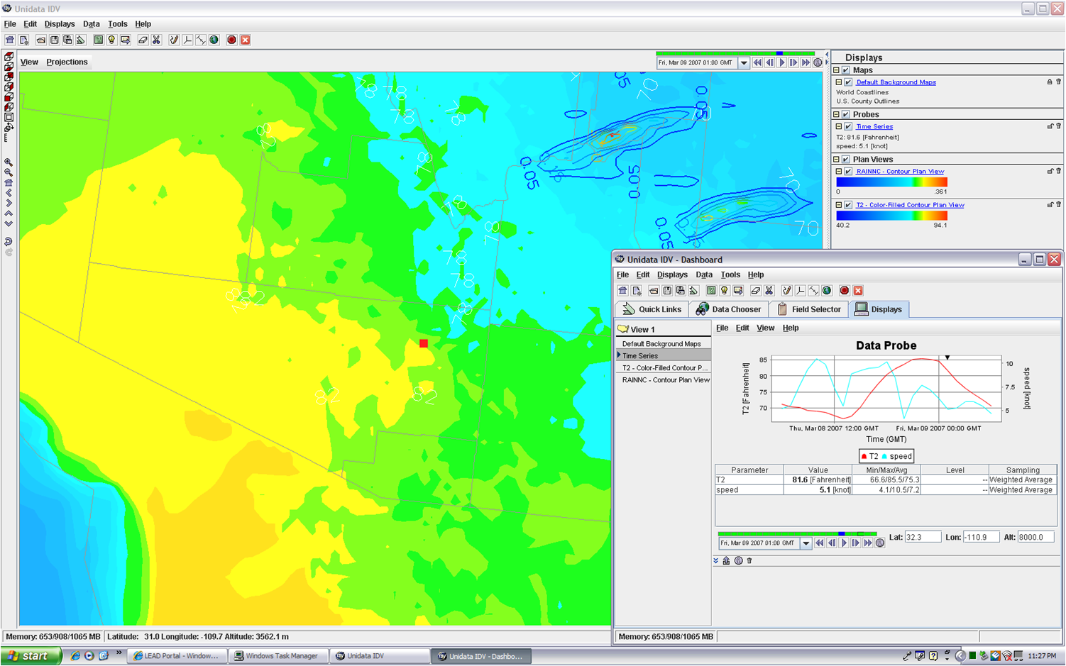
In the classroom

Slide 11
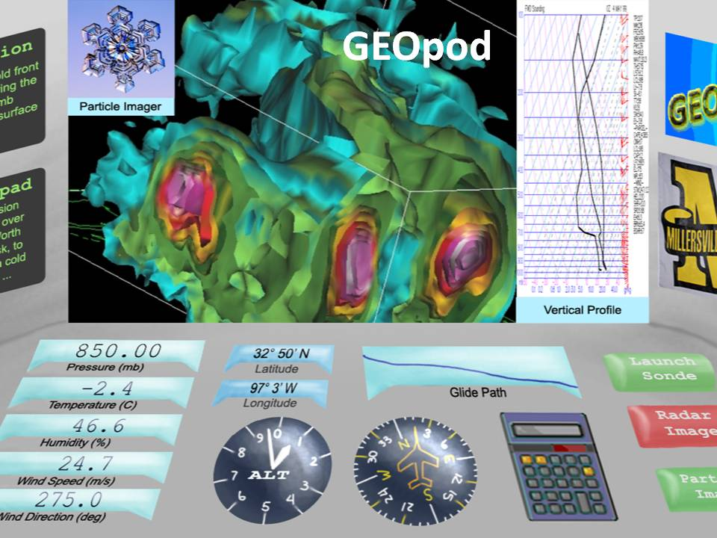
Opportunity
High resolution road weather forecasts for state DOTs
RWIS, Vehicle IntelliDrive systems bringing millions of observations
COSMIC, and large volume datasets from new satellite platforms
Air quality data and forecasts
Integrated Web Services
Cloud computing environments
LEADERSHIP

Slide 12
Unidata everyday
Campus Weather Service
WxChallenge
Student Research
Data ingest for WRF initialization
Classroom supplement
Learning new acronyms ☺

Slide 13
netCDF from the TDS
CDM thru the IDD
Gets sucked into the LDM
And spewed out to the user through IDV

Slide 14
Happy 25th Anniversary
Tina
John
Ethan
Ben
Ginger
Steven
David
Jo
Ed
Dennis
Yuan
Mike J.
Robb
Brian
Jeff M.
Linda
Terry
Don
Jennifer
Mohan
Russ
Mike S.
Jeff W.
Tom
Thank you Unidata. We couldn’t do it without you.

